Slide 1
Polygons
Match the descriptions with the formulas

Slide 2
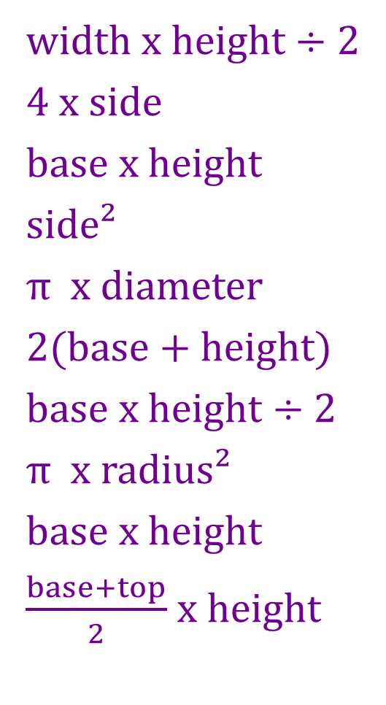
area of a rectangle
area of a triangle
area of a parallelogram
area of a square
area of a kite
area of a trapezium
area of a circle
perimeter of a square
perimeter of a rectangle
circumference of a circle
width x height ÷ 2
4 x side
base x height
side²
π x diameter
2(base + height)
base x height ÷ 2
π x radius²
base x height
$\frac{base+top}{2}$ x height

